Slide 1
Ascending Triangle Detection from SP 500 Index
Muhammed Fais
Data Science | Machine Learning | Deep Learning | Computer Vision
Email : fayismohd1123@gmail.com
Linkedin: https://www.linkedin.com/in/muhammed-fais-p/
Github: https://github.com/Muhammed-Fais

Slide 2
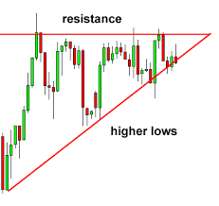
Problem Statement
The problem was to develop a small pattern identification model that could detect ascending triangles in the S&P 500 index data. The dataset contained more than 12,000 bars or candles, with basic information such as the timestamp, open, high, low, close, for each hour, for two years from January 1, 2021, to December 31, 2022.

Slide 3
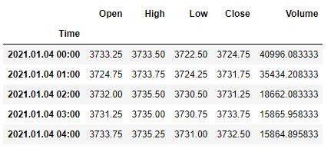
Dataset Overview
The dataset was provided in a CSV file, but it contained some problems that needed to be fixed. The CSV file was converted to an Excel file to make it easier to work with. Additionally, a volume column was added to the dataset to get better results from the pattern identification model.

Slide 4
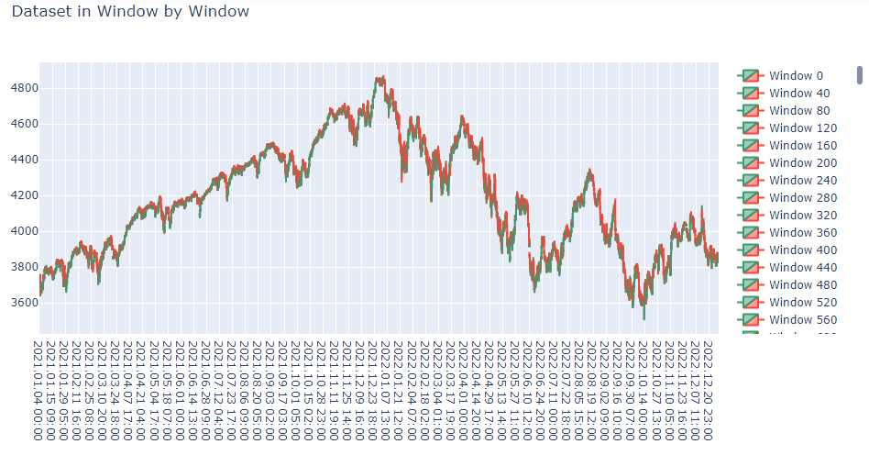
My Approaches
The Python program started by importing the necessary libraries, including Pandas and Plotly. The dataset was then loaded into a Pandas DataFrame and preprocessed by converting the timestamp column to a datetime object and setting it as the index.
After that I creates a candlestick chart using Plotly to visualize the price data in windows of 40 candles at a time. The for loop iterates through the DataFrame in increments of 40 candles, creating a window DataFrame for each iteration. The resulting chart shows the price data in a sliding window view, with each window offset by 40 candles from the previous one. The chart also includes a volume bar chart for each window to show the trading volume of each candle.

Slide 5
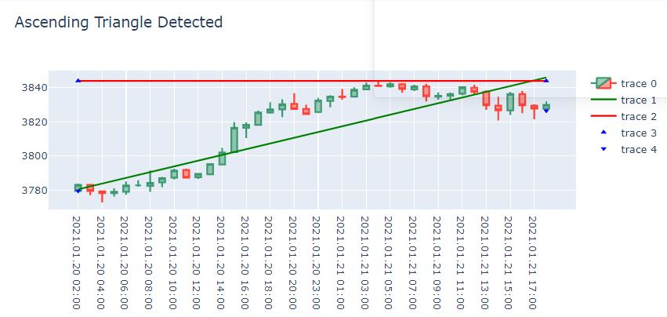
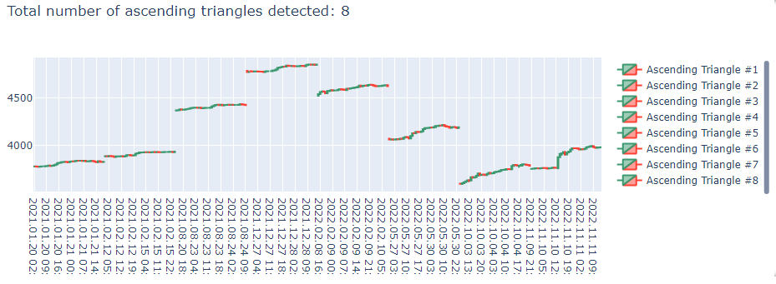
The pattern identification model used to detect ascending triangles was implemented as a function called detect_ascending_triangle() . This function takes a window of data as input and returns a modified version of the data with an additional column indicating whether an ascending triangle pattern was detected in that window.
The main loop of the program iterates through the dataset in windows of 40 bars/candles and calls the detect_ascending_triangle() function on each window. If an ascending triangle pattern is detected in a window, the program increments a counter and adds a candlestick chart of that window to a Plotly figure.
After iterating through the entire dataset, the program updates the layout of the Plotly figure to include a title indicating the total of 8 ascending triangles detected, and displays the figure using the show() method.

Slide 6
Case Study
The Python program successfully detected ascending triangles in the S&P 500 index data and plotted them using a candlestick chart in a Plotly figure. The output included information on the number of ascending triangles detected in the dataset.
The features being detected for an ascending triangle in this model are:
Series of higher lows: The code checks if the pattern has a series of higher lows that form an ascending trendline.
Ascending trendline: The code calculates the trendline by fitting a linear regression model to the series of higher lows and checks if it has at least 3 points.
Horizontal line: The code calculates the horizontal line by finding the maximum high value in the DataFrame.
Intersection of trendline and horizontal line: The code detects the ascending triangle by checking if the trendline intersects with the resistance line.
Visualization: If an ascending triangle is detected, the code creates a candlestick chart and adds the trendline, horizontal line, and annotations as additional traces to the figure. It also increments a counter and displays a message indicating the number of ascending triangles detected.

Slide 7
Conclusion
In conclusion, the pattern identification model implemented in this Python program successfully detected ascending triangles in the S&P 500 index data, providing valuable insights into the market trend. The program could be further improved by implementing other pattern identification models to detect additional trends in the dataset.
Advantages of the pattern identification model can be summarized as follows:
Automation: The model automates the process of identifying ascending triangle patterns in financial data, eliminating the need for manual analysis and reducing the likelihood of human error.
Efficiency: The model can quickly analyze large amounts of financial data, allowing traders to make informed trading decisions in a timely manner.
Visualization: The model produces visualizations of the identified patterns, making it easier for traders to understand and interpret the data.
Adaptability: The model can be adapted to analyze other financial data and identify different patterns, providing a versatile tool for traders and analysts.

